Slide 1
CSE 103
Structured Programming
Lecture 01: Introductory Class
Md. Asif Khan Rifat Lecturer, East West University

Slide 2

Course Resources
❏ Google Classroom Code: kl3fajf
❏ All teaching materials will be uploaded to google classroom.
2

Slide 3
Course Outcomes
Objective 1: Understand and apply the fundamentals of programming, basics of elementary programming, and different control statements in the target language.
Objective 2: Understand and apply the different types of arrays and functions for implementing structured programs.
Objective 3: Understand different data structures, user defined data types, and dynamic memory for implementing structured programs.
Objective 4: Demonstrate skills to choose appropriate language constructs and data structures to design, build and test realistic, complex applications.
3

Slide 4
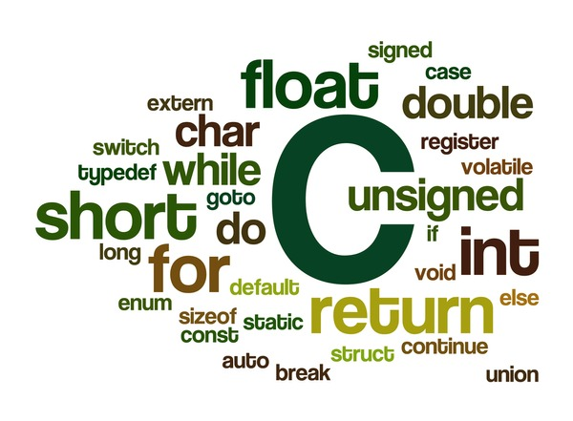
Course Topics
❏ Introduction to Programming
❏ Basic Syntax and Structure of C
❏ Data Types, Variables, and Operators
❏ Control Structures (if-else & loops)
❏ Functions and Recursion
❏ 1D, 2D Arrays and Strings
❏ Pointers and Memory Management
❏ Structures
❏ File I/O (Input/Output)
❏ Error Handling and Debugging
❏ Dynamic Memory Allocation
4

Slide 5
Learning Style
❏ This course is practical oriented.
❏ Memorization will not help you to get a good result.
❏ Three key techniques to perform better in this course:
Practice
Practice &
Practice
• Copying Code:
• Strictly prohibited.
• Will be severely punished if you are caught.

Slide 6
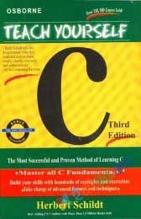
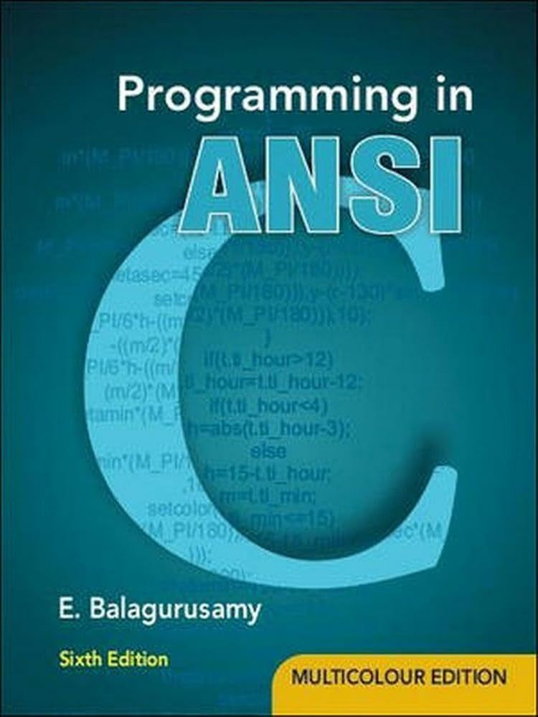
Reference Books
Teach Yourself C by Herbert Schildt
Programming in ANSI by E. Balagurusamy

Slide 7
Timetable Synopsis
❏ Lectures
❏ Day & Time:
❏ Section 10 (MW 8:30 PM – 10:00 PM)
❏ Office Hours
❏ Day & Time: Refer course outline
❏ Room: AB3-303
Email: asif.rifat@ewubd.edu
Do not hesitate to contact if you have any concerns or questions.

Slide 8
Marks Distribution
❏ Class Test/Quizzes: | 10%
❏ Mid-term Assessment: | 30%
❏ Final Exam: | 30%
❏ Lab Performance/ Experiments: | 10%
❏ Lab Final: | 10%
❏ Mini Project (Group Based): | 10%
Grading Policy: As per EWU grading system
No Makeup exam will be taken except medical issues.

Slide 9
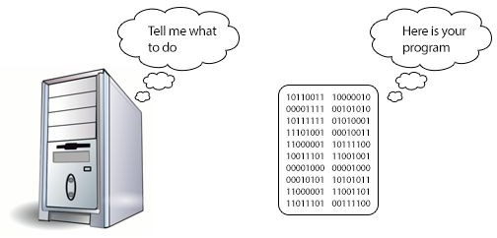
What is Computer Programming?
A computer program is a sequence of instructions written to perform a specific task within a computer.

Slide 10
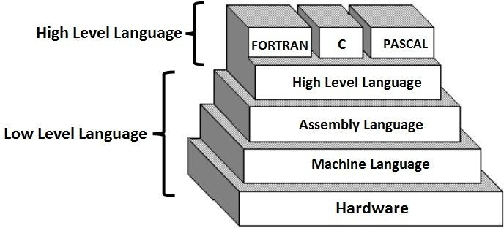
Types of Programming Language
Programming Language are of three types:

Slide 11
Structured Programming
Structured programming or modular programming is a programming paradigm that facilitates the creation of programs with readable codes and reusable components.
Key Principles:
❏ Modularity: Breaking down programs into smaller, manageable functions.
❏ Control Flow: Using structured control statements like loops and conditionals.
❏ Block Structures: Grouping related code in blocks for better readability.
11

Slide 12
C: Structured Programming Language
❏ History: Developed in the 1970s at Bell Labs by Dennis Ritchie.
❏ Popular Use Cases: Operating systems, embedded systems,
hardware drivers.
❏ Low-Level Access: Provides direct access to memory and hardware, making it powerful for system-level programming.

Slide 13
A Simple C Code
#include <stdio.h> int main()
{
/* My first program in C */ printf(“Welcome to CSE 103”);
Preprocessor
Main Function
Begin of program
Statements
return 0;
End of program
}

